Slide 1
UI & Schedule Format for Auto Box Test
New Feature Release
Version 2.01

Slide 2
New Feature Introduction
Image Comparison function and comparison result report.
Add Pause button.
Add Preview camera video.
Add timer button and Schedule Timer list.
Add progress bar.
Modify UI program style.
Drop-down list of RC key.
Add unknown camera manual setting.
On line schedule edit and save function.
Release Script Template V2.01.

Slide 3
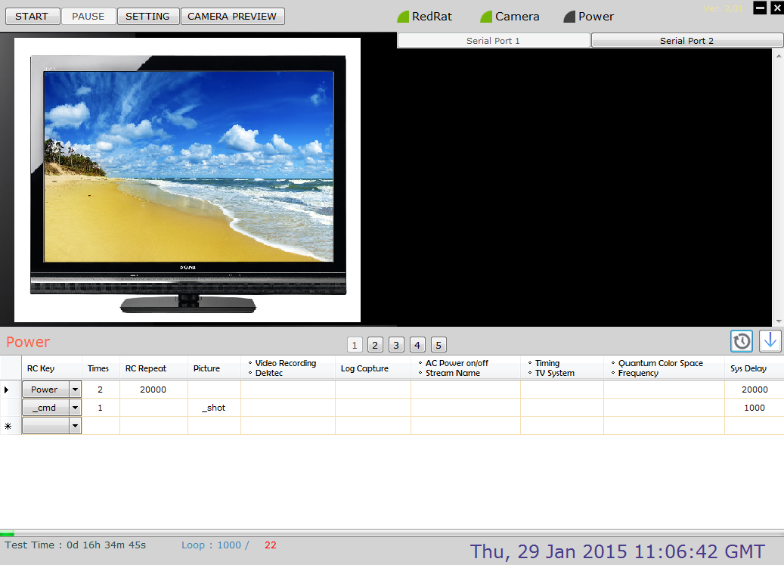
UI Introduction - Main Screen
New feature:
Start / Pause stress test
Enter setting page
New feature:
Preview camera video
Change Serial port
Camera
Video
Log
Data
New feature:
Save as schedule file
Schedule
Command
Schedule RC key info
Switch Schedule

Slide 4
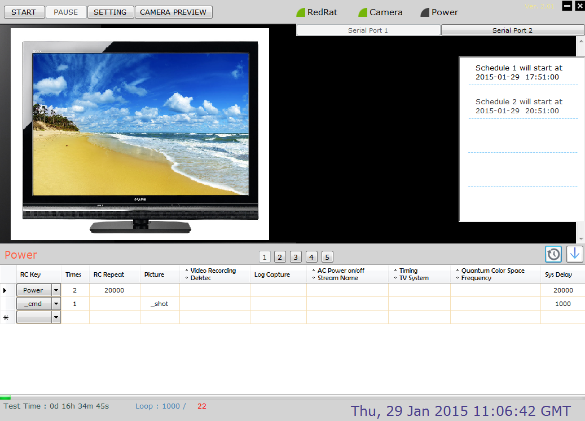
UI Introduction - Main Screen
Version info
New feature:
IF you set Schedule Timer, schedule will auto to start,
user does not need to press [START ] button.
Schedule
Timer
New feature:
Pop Schedule Timer list
New feature:
drop-down list of RC key
New feature:
Schedule progress bar
Test time of schedule
Total loop / Current loop

Slide 5
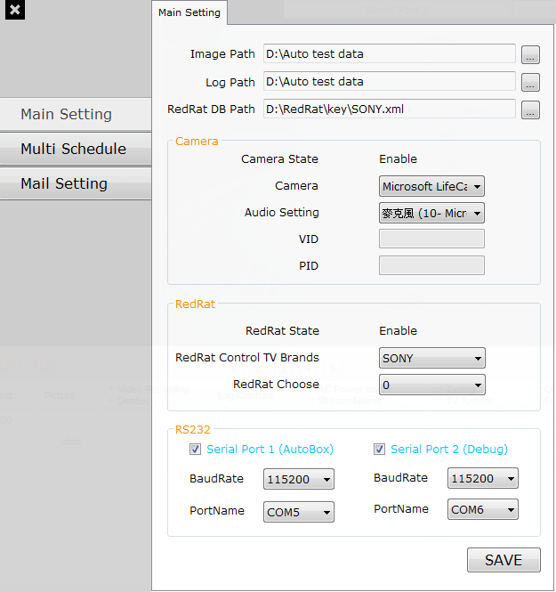
UI Introduction – Main Setting
Select location to save photo and log, load RC DB.
Camera setting, select your camera device.
New feature:
User can add camera data manually.
RedRat setting, select RedRat database.
Secord RS232 setting, select your comport and baudrate.
Press “SAVE” button to save date

Slide 6
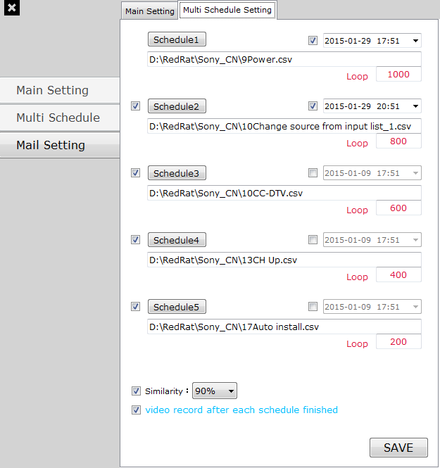
UI Introduction – Multi Schedule Setting
Press to load schedule file.
New feature:
Start time of schedule.
Setting how many times to test for a schedule.
New feature:
Enable or not to run schedule.
New feature:
Similarity of Image Comparison.
Video record after each schedule finished.
Press “SAVE” button to save date.

Slide 7
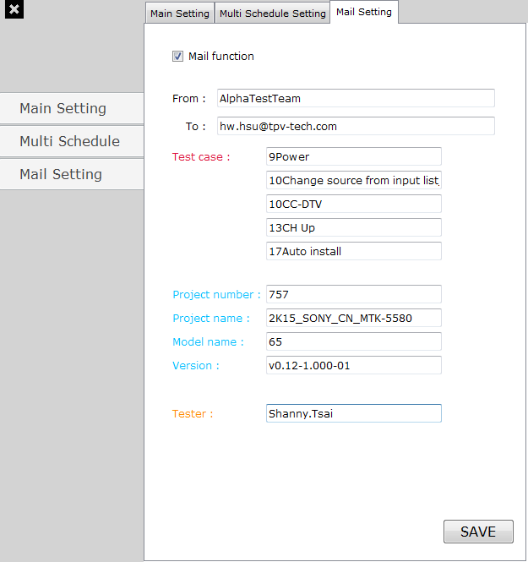
UI Introduction – Mail Setting
Enable or not to send mail after stress test finished.
If you enable it, [Form] and [To] must be filling in data.
Filling in information for mail.
New information:
Project number of URTracker.
Press “SAVE” button to save date

Slide 8
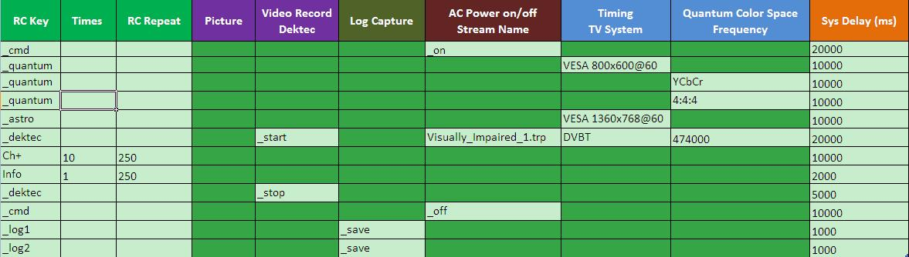
Schedule Example
System Setting :
Working folder setting
Input the schedule description
Execute by test times
Soft Remind:
Please use Script Template V2.01.xlsx to edit Schedule
If want use old Schedule, please transform new format

Slide 9
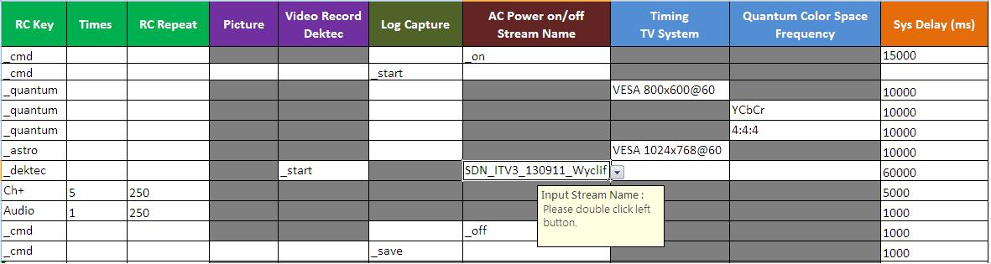
Define RC Key for Equipment Operation
Select RC key from pull-down list
“_quantum” or “_astro” is reserved for Auto Stress Test Equipment Control Command
Select Timing from pull-down list
Change color space for Quantum, can select from pull-down list
Define how many times this RC key is repeated
no repeat if empty
set stream to play, click twice can fill stream name
Define waiting duration before next RC key step
0 ms if empty

Slide 10
Define RC Key Operation
Select RC key from pull-down list
“_cmd” is reserved for Auto Stress Test System Control Command
Define waiting duration after each RC key sent
0 ms if empty
RC Key | Times | RC Repeat (ms) | … | Sys Delay (ms)
Menu | 1 |  | … | 300
Exit |  |  | …
Vol+ | 3 | 100 | … | 1000
Ch+ | 2 | 3000 | … | 300
Define how many times this RC key is repeated
no repeat if empty
Define waiting duration before next RC key step
0 ms if empty

Slide 11

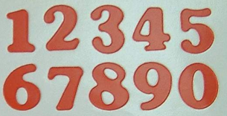
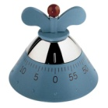
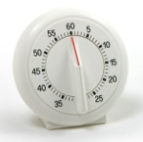





RC Key Operation Spec
RC Key | Times | RC Repeat (ms) | … | Sys Delay (ms)
Menu | 3 | 250 | … | 2000
NEXT RC
Menu
Menu
Menu

Slide 12
Define System Control Operation
“_cmd” is System, ”_log1; _log2” for COMport use, not RC key
Record Video/Audio
“_start”, “_stop”
System Power
“_on”, “_off”
Take a picture
“_shot”
Record RS232 message, by “_save”
Clear message by “_clear”
Except with “_” prefix, all text is sent to TV, “Enter” key is added automatically
Waiting time
0 ms if empty

Slide 13


Similarity Report Example
Similarity default setting = 90%
No. | Target | Source | Similarity | Sub-NG count | NG Rate | Result
1 | 1-1 | 2-1 | 80% | 1 | 1 | NG
2 | 1-2 | 2-2 | 90% | 0 | 0 | Pass
3 | 2-1 | 3-1 | 80% | 2 | 1 | NG
4 | 2-2 | 3-2 | 80% | 1 | 0.5 | NG
5 | 3-1 | 4-1 | 90% | 2 | 0.67 | Pass
6 | 3-2 | 4-2 | 90% | 1 | 0.33 | Pass
7 | 4-1 | 5-1 | 90% | 2 | 0.50 | Pass
8 | 4-2 | 5-2 | 90% | 1 | 0.25 | Pass
9 | 5-1 | 6-1 | 90% | 2 | 0.40 | Pass
10 | 5-2 | 6-2 | 90% | 1 | 0.20 | Pass
11 | 6-1 | 7-1 | 90% | 2 | 0.33 | Pass
12 | 6-2 | 7-2 | 90% | 1 | 0.17 | Pass
2nd loop compare
3rd loop compare
4th loop compare
5th loop compare
6th loop compare
7th loop compare
80%
90%
1-1
2-1
1-2
2-2
Target
Source
Target
Source
Target: Previous loop photo (click URL to pop image file)
Source: Current loop photo (click URL to pop image file)
Similarity: Target and source file to compare, similarity of Image Comparison.

Slide 14
Similarity Report Example
Similarity default setting = 90%
No. | Target | Source | Similarity | Sub-NG count | NG Rate | Result
1 | 1-1 | 2-1 | 80% | 1 | 1 | NG
2 | 1-2 | 2-2 | 90% | 0 | 0 | Pass
3 | 2-1 | 3-1 | 80% | 2 | 1 | NG
4 | 2-2 | 3-2 | 80% | 1 | 0.5 | NG
5 | 3-1 | 4-1 | 90% | 2 | 0.67 | Pass
6 | 3-2 | 4-2 | 90% | 1 | 0.33 | Pass
7 | 4-1 | 5-1 | 90% | 2 | 0.50 | Pass
8 | 4-2 | 5-2 | 90% | 1 | 0.25 | Pass
9 | 5-1 | 6-1 | 90% | 2 | 0.40 | Pass
10 | 5-2 | 6-2 | 90% | 1 | 0.20 | Pass
11 | 6-1 | 7-1 | 90% | 2 | 0.33 | Pass
12 | 6-2 | 7-2 | 90% | 1 | 0.17 | Pass
2nd loop compare
3rd loop compare
4th loop compare
5th loop compare
6th loop compare
7th loop compare
Sub-NG count: Count the number of NG result
Sub-NG count_3= Sub-NG count_1 + Sub-NG count_3
Sub-NG count_5= Sub-NG count_1 + Sub-NG count_3 + Sub-NG count_5
NG Rate: The rate of Sub-NG count and Sub grand total
NG Rate_5 = Sub-NG count_5 / count(1,3,5) = 2/3 = 0.67
Result: Result of Image Comparison

Slide 15
Trouble Shooting
Environment check:
File path/directory path are correctly set
Disable “Power saving” settings in PC/NB so that Auto Test won’t be affected by HD or peripheral power-down
I cannot find the RC key I need from pull-down list
Please report to RC database administrator
No Response on TV
Please make sure all indicators are correct
Please make sure RC protocol is set correctly
RC Key operation is lost occasionally
Duration of RC repeat and Sys delay should be sufficient for TV operation
The response time of TV is various over different RC and TV models
It is recommended to execute RC operation manually before setting RC repeat and Sys delay
Equipment connect to Auto box
ASTRO VG871-B/ VG872-C and Quantum 882/ Dektec Gold-215

Slide 16
Trouble Shooting
6. Multi Schedule:
Can set 5 schedules in stress test
Shorten the time
7. Mail system:
When test finish can send Mail to personnel
8. Install:
If you first install Auto Test program, please put config.ini and mail.ini file to Auto Test folder after install.
9. Time start:
If program enable Start time of schedule, please don’t press “ START ”button, program will automatic start on set time.

